Slide 1


Controlador de Semáforos
Realizado por: Pedro Sousa e Leonardo Hügens

Slide 2
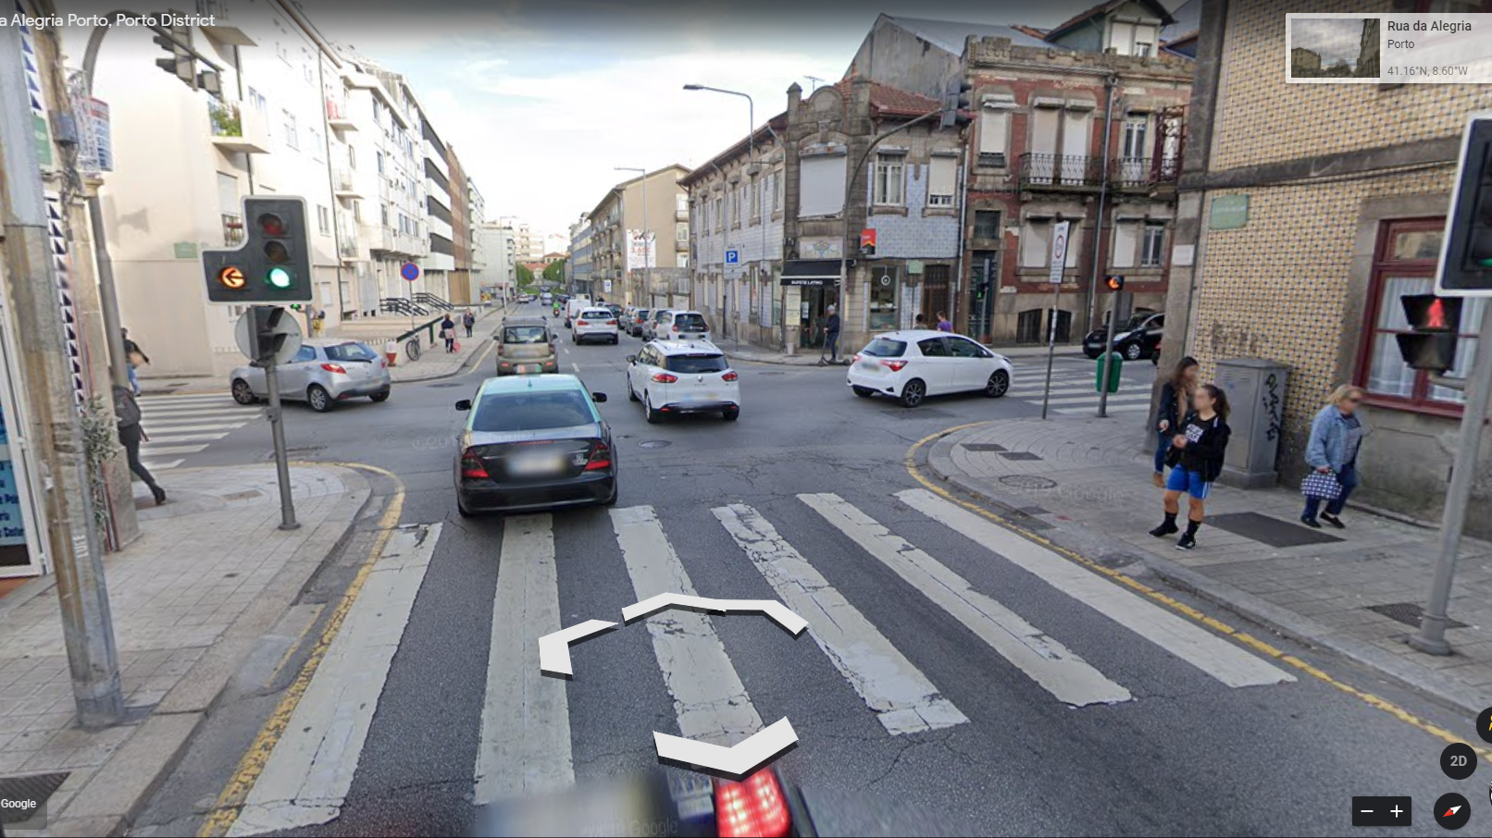

Slide 3
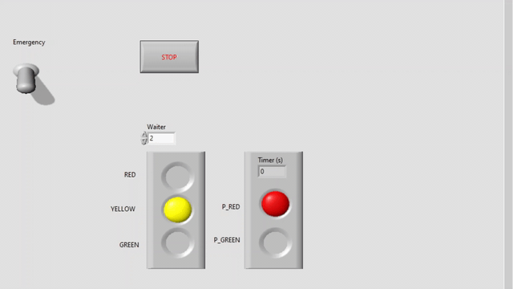

Alpha_0.1

Slide 4
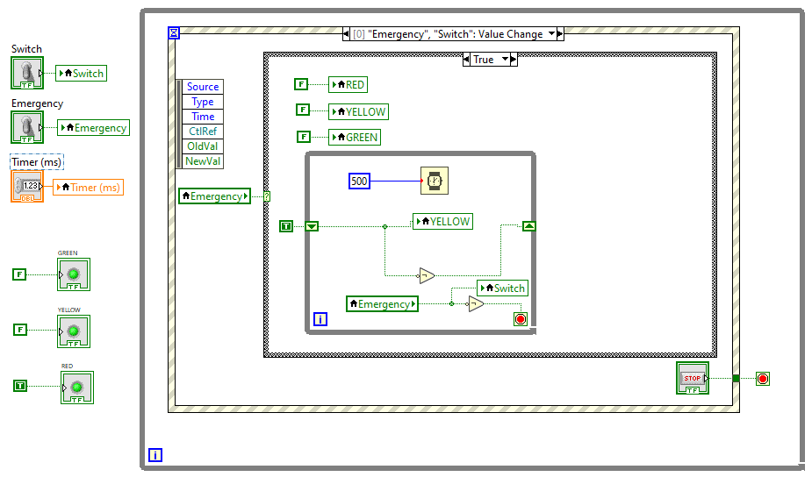
Alpha_0.2

Slide 5
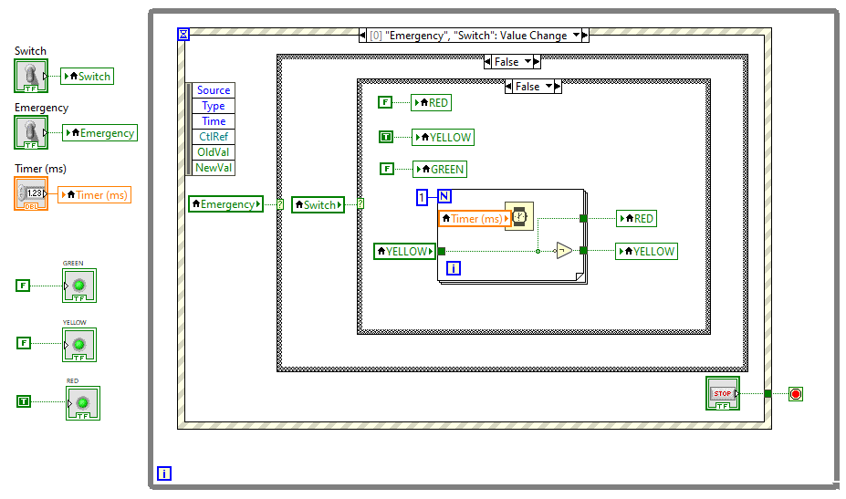
Alpha_0.2

Slide 6

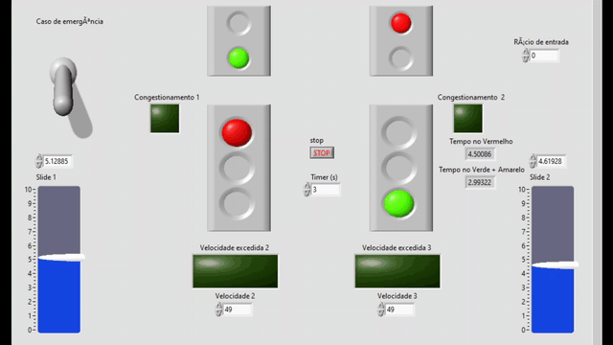
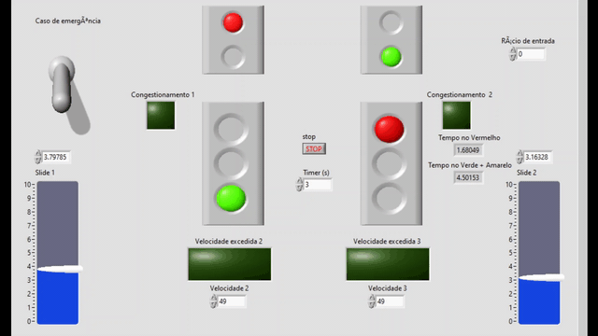
Alpha_0.3

Slide 7
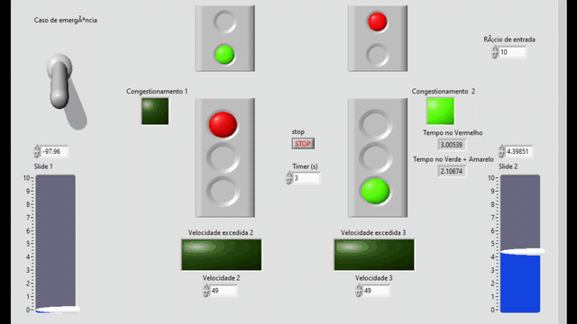
Alpha_0.3

Slide 8
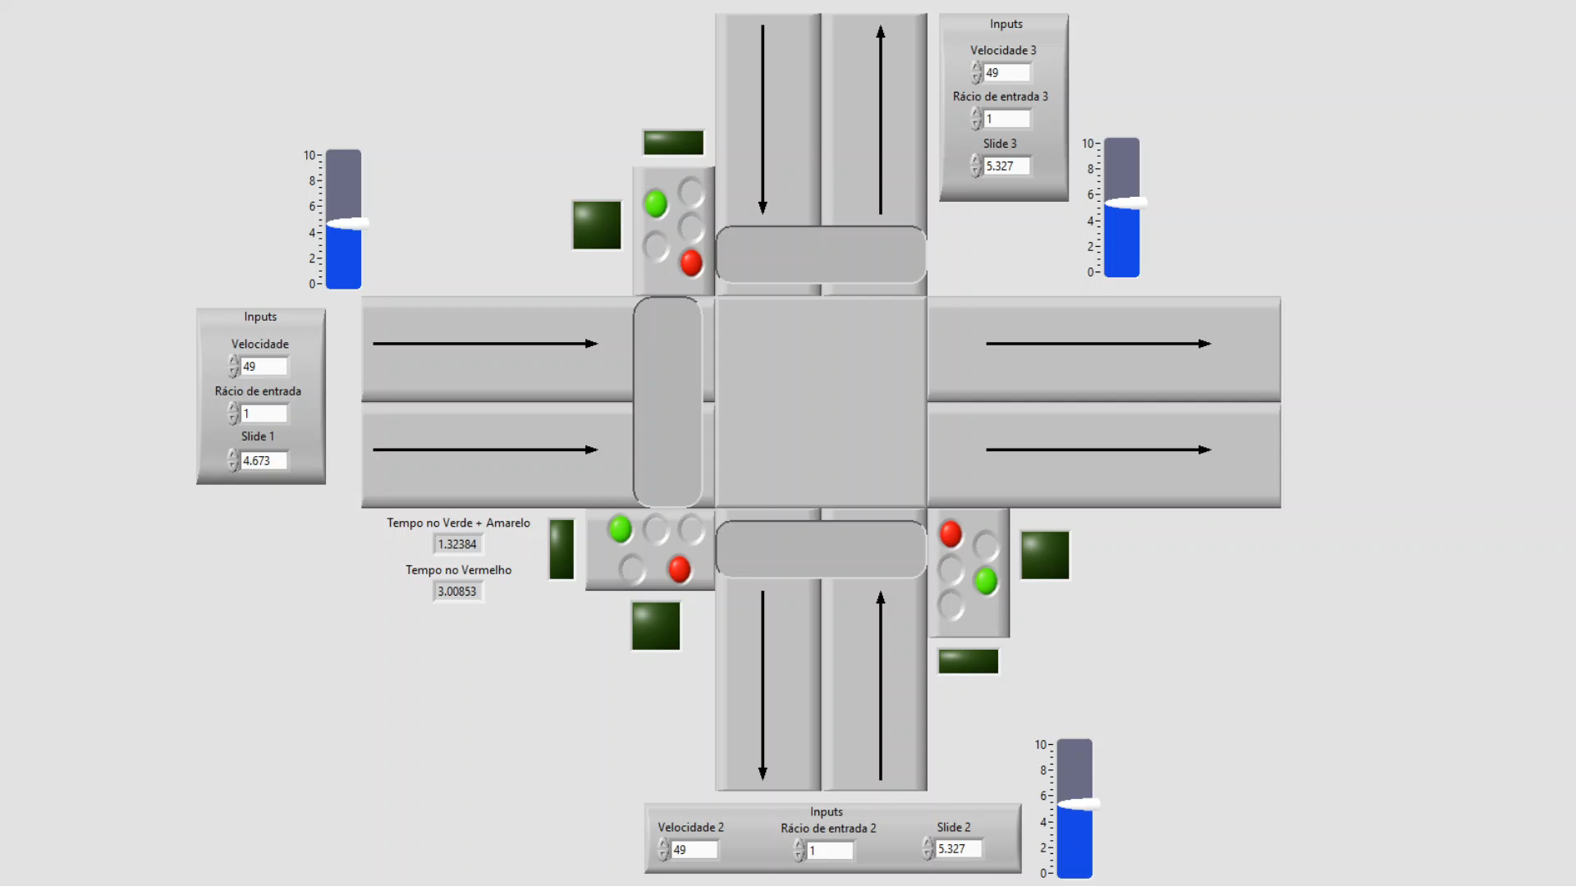
Alpha_0.4

Slide 9
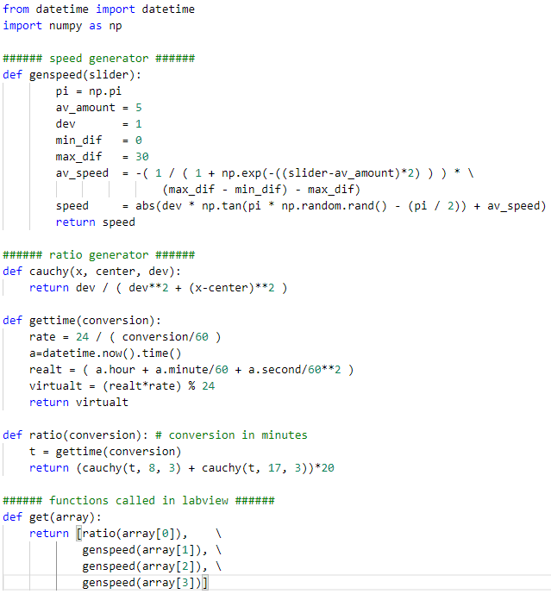
Alpha_0.5,0.6

Slide 10
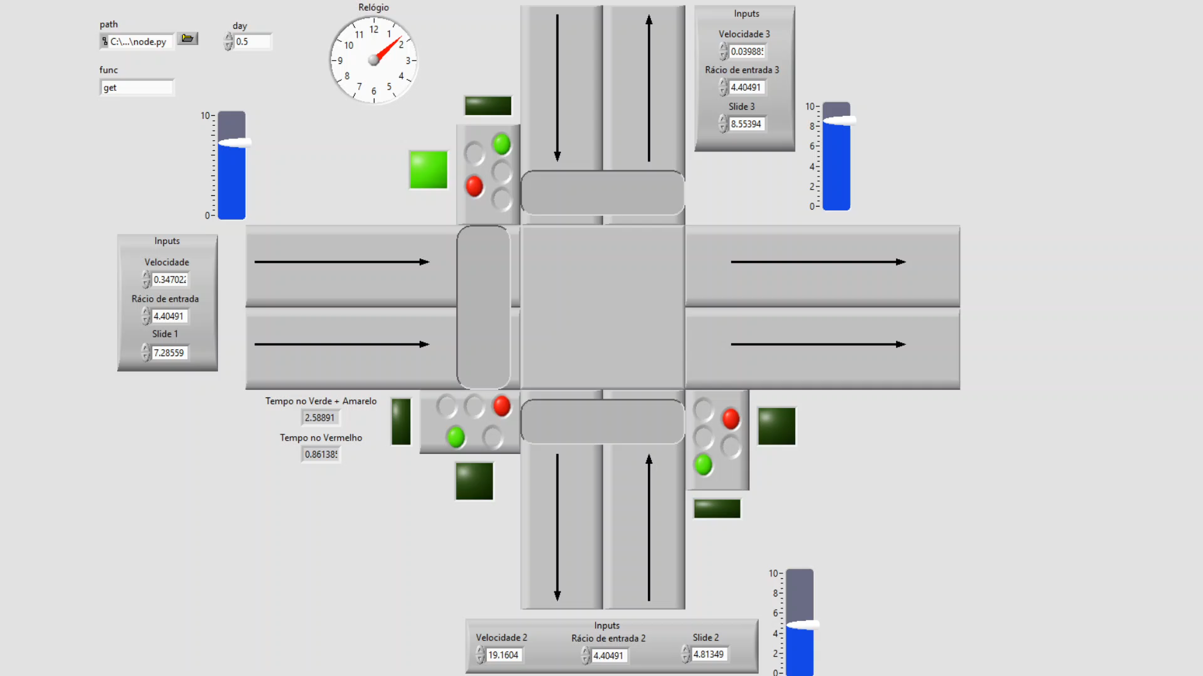
Alpha_0.6

Slide 11
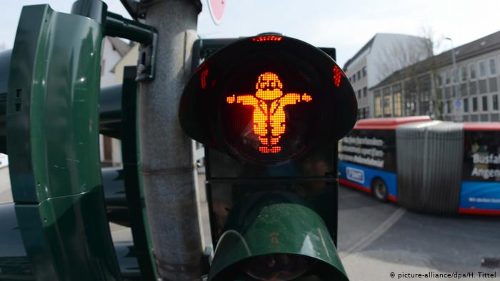
Conclusões

